Slide 1

Problem Statement and Team Details
Problem Statement:
Team Name: CHAOS
Team Leader Name: B.Jogeshwar
Institute Name: KLH University
Team Leader Email ID: 2320040055@klh.edu.in
Managing money is tough — whether for a startup founder, a student fest organizer, or a small business owner

Slide 2
Problem and Solution
Describe your problem statement and how you are solving it.
Problem: Small business owners, startup founders, and event organizers struggle with financial decisions like “Can we afford 2 more hires?” or “What happens if we increase prices by 10%?” Manual spreadsheets are slow, error-prone, and unclear.
Solution – CFO Helper: An interactive finance assistant that makes “what-if” planning simple.
Key Features:
Adjust Inputs: Quickly tweak spending, hiring, or pricing.
Visualize Impact: See instant forecasts and charts for cash flow and runway.
Export Reports: Share concise summaries of scenarios.
Usage Tracking: Monitor how many scenarios you’ve tested.

Slide 3
Methodology & Implementation
cFO Helper – Short Implementation Plan
UI: Sliders for spending/hiring/pricing, charts & text summaries, exportable mini-reports.
Backend: Recalculate budget, cash flow, and profit; store scenarios & usage count.
Flexprice: Bill per scenario/report, show usage counter.
Pathway: Pull mock financial data and update forecasts live.
Stack: React + Recharts (frontend), Node.js/Flask (backend), Flexprice API, Pathway API.
C

Slide 4
Technology Used
Frontend:
React.js – For building interactive UI and sliders
Chart.js / Recharts – To display charts and forecasts
HTML/CSS – Basic structure and styling
Backend:
Node.js + Express or Python Flask – For calculations, data handling, and APIs
Integrations:
Flexprice API – Billing per scenario and report export
Pathway API – Pulling mock financial data for real-time updates
Other Tools:
PDF / CSV Export Libraries – For generating shareable reports
Local Storage or Database (MongoDB/MySQL) – To store scenarios and usage count

Slide 5
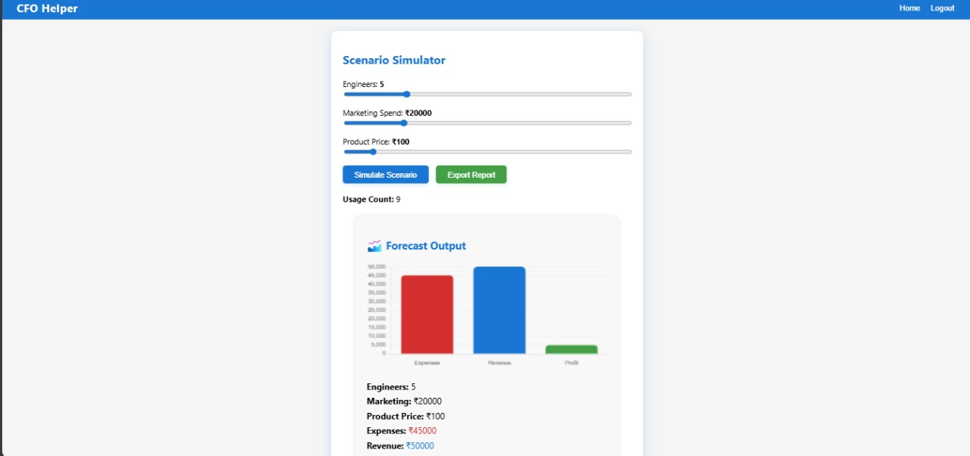
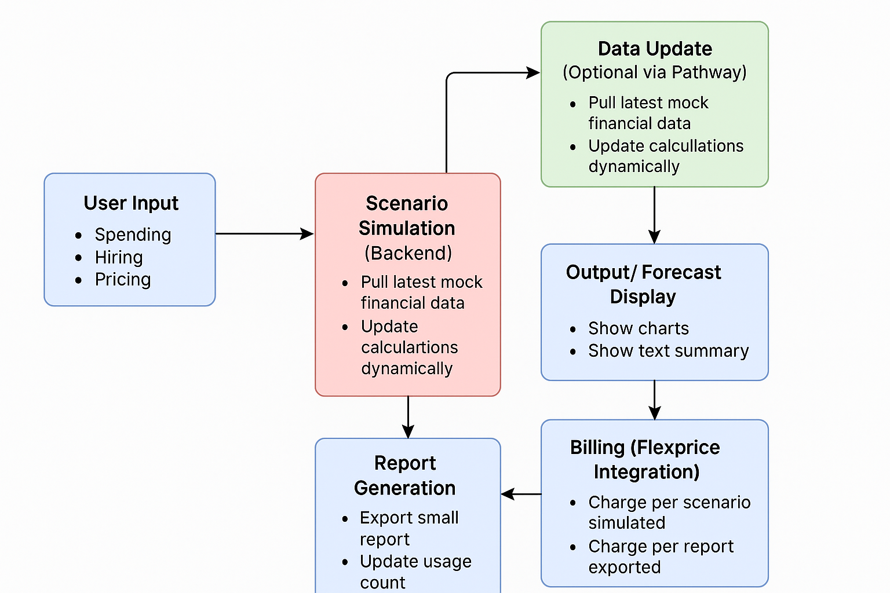
Flowchart & Supporting Images
Supporting Images
Flowchart

Slide 6
Feasibility and Market Use
Feasibility
Technical: Straightforward to build using React (UI), Recharts/Chart.js (visuals), and Node.js/Flask (backend). Flexprice and Pathway APIs simplify billing and data integration.
Operational: Works with mock data for MVP; can scale to real accounting tools later (e.g., QuickBooks, Xero).
Financial: Low initial cost—most components are open source. Revenue model via pay-per-scenario/report is sustainable.
Timeline: MVP achievable in 6–8 weeks with a small dev team.
Market Use
Startups: Quickly test hiring, pricing, and spending decisions without complex software.
Small Businesses: Simplifies budgeting compared to expensive CFO services or clunky spreadsheets.
Event Organizers & NGOs: Forecast event costs and cash flow for grants or sponsorships.
Freelancers & Creators: Plan income/outgoings to avoid financial surprises.

Slide 7
Conclusion
CFO Helper makes financial planning simple, fast, and clear. By combining interactive sliders, real-time forecasts, and easy report sharing, it fills the gap between basic spreadsheets and expensive CFO services—empowering startups, small businesses, and organizers to make smarter, data-driven decisions.

Slide 8
https://github.com/MallikaTanneru/CFO_Helper

